Slide 1

Cover Page
Agentic RAG Chatbot
for Multi-Format Document QA using MCP
By: Bandi Srinivas Tech Stack: Python, Streamlit, FAISS, HuggingFace Date: July 2025

Slide 2
ROBOTS COLORING BOOK – PICTURE 1
Modular Agentic Architecture System design includes three modular agents and MCP-based orchestration.
Agents:
Ingestion Agent: Parses and chunks document text.
Retrieval Agent: Embeds and retrieves relevant chunks.
LLM Response Agent: Generates final answer from LLM using context.
MCP (Model Context Protocol):
Standard message objects passed between agents.
Traceable, reusable, and scalable pipeline.

Slide 3
ROBOTS COLORING BOOK - PICTURE 2
System Workflow (With MCP)
System Message Flow:
User Uploads Documents → UI
CoordinatorAgent triggers:
IngestionAgent → parse + chunk
RetrievalAgent → embed + retrieve
LLMResponseAgent → prompt + generate answer
Chatbot UI → Displays Final Answer + Source
Supported Formats: PDF, DOCX, PPTX, CSV, TXT

Slide 4
ROBOTS COLORING BOOK – PICTURE 3
Technology Used
Component | Libraries
Language | Python
UI Framework | Streamlit
File Parsing | PyMuPDF, python-docx, python-pptx, pandas
Embeddings | HuggingFace
Vector Database | FAISS
Orchestration | Model Context Protocol (MCP)
LLM | OpenAI & HuggingFace

Slide 5
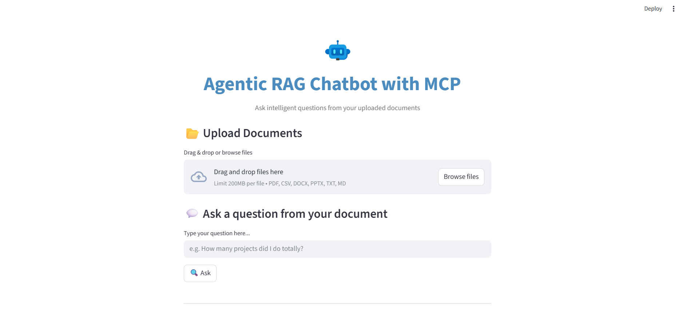
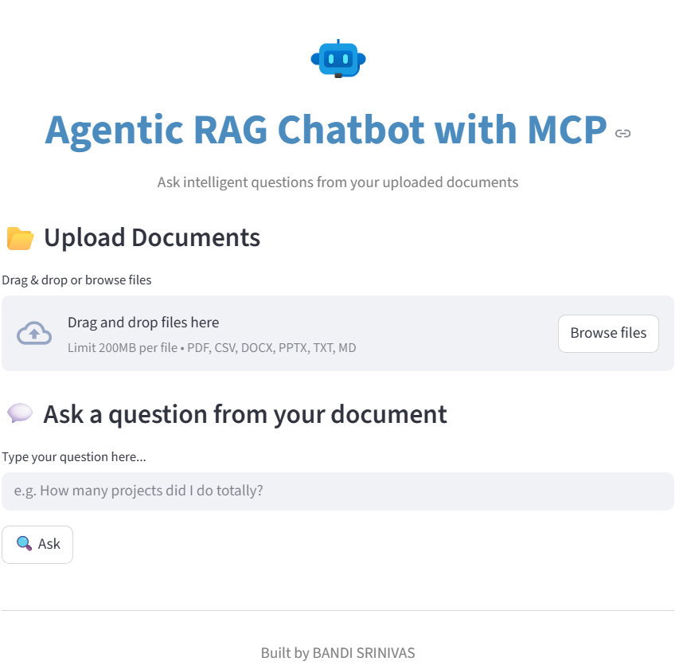
ROBOTS COLORING BOOK - PICTURE 5

Slide 6
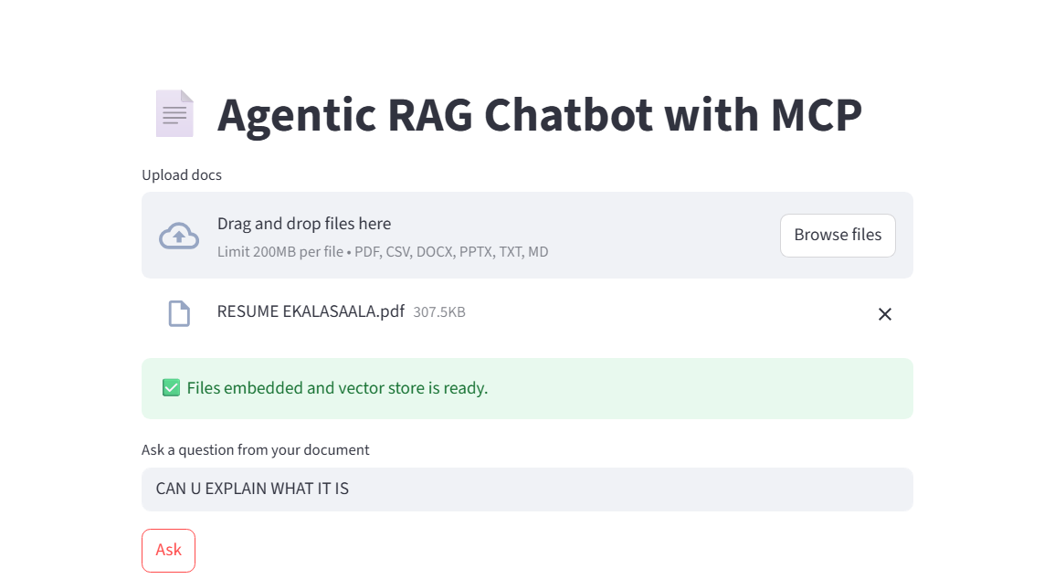




ROBOTS COLORING BOOK - PICTURE 5
HERE I INSERT THE PDF

Slide 7
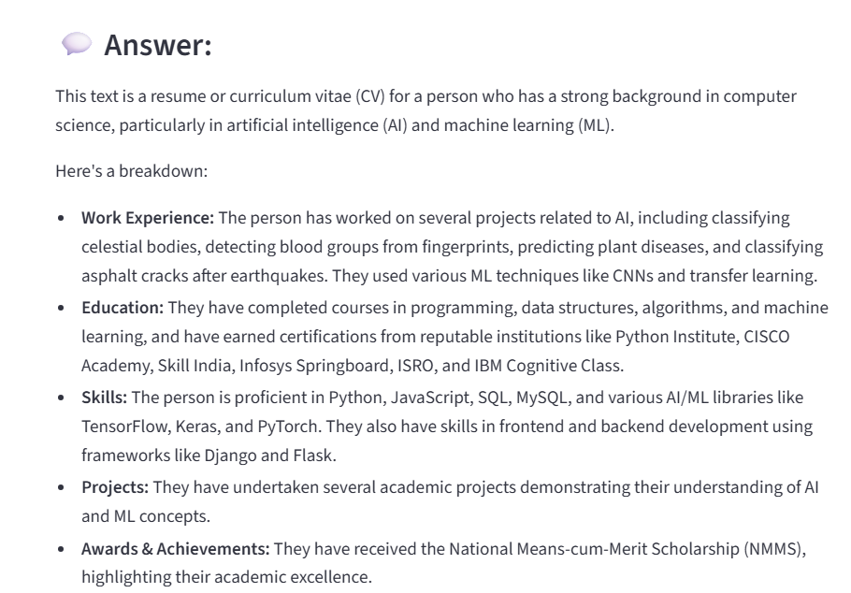
ROBOTS COLORING BOOK - PICTURE 5

Slide 8
ROBOTS COLORING BOOK - PICTURE 4
Challenges & Future Scope
Challenges Faced
Parsing inconsistencies in PPTX & Markdown
Optimizing chunk sizes for accurate retrieval
Ensuring low-latency embeddings and FAISS search
Future Scope
Support multiple LLM provider
Add summarization agent

